Slide 1
Methodology
A software development methodology in software engineering is a framework that is used to structure, plan, and control the process of developing an information system.

Slide 2
6 Methodology
Waterfall Methodology
Jupiter is the biggest planet of them all
Incremental Methodology
Spiral Methodology
Scrum Methodology
RUP Methodology
Extreme Programming

Slide 3
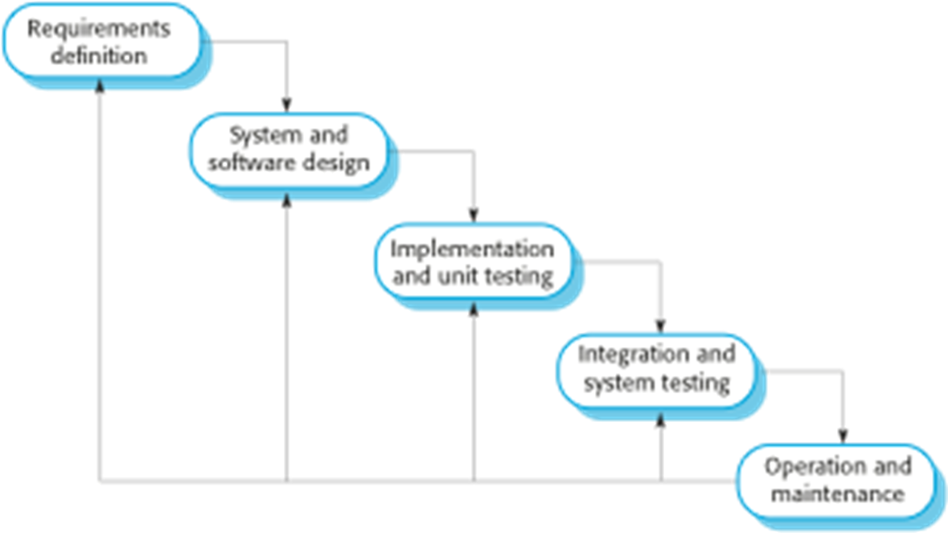
Waterfall Methodology
Plan-driven model.
Separate and distinct phases of specification and development.

Slide 4
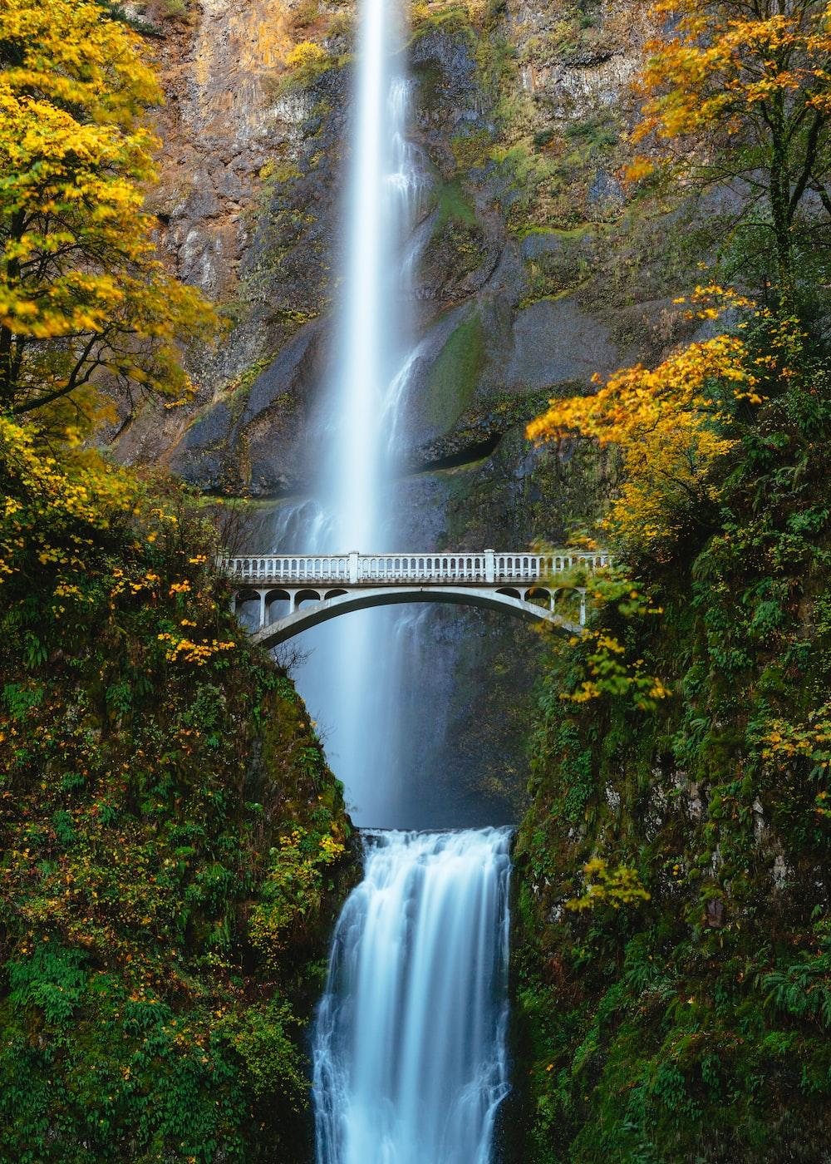
Waterfall Methodology
Advantages
Simple and easy to understand and use
Easy to arrange tasks.
Clearly defined stages.
Disadvantages
The main drawback of the waterfall model is the difficulty of accommodating change after the process is underway. In principle, a phase has to be complete before moving onto the next phase.

Slide 5
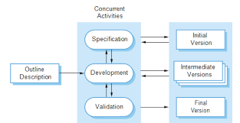
Incremental Methodology
Incremental Model is a process of software development where requirements divided into multiple standalone modules of the software development cycle.

Slide 6
Incremental Methodology
Advantage
The cost of accommodating changing customer requirements is reduced.
It is easier to get customer feedback on the development work that has been done.
More rapid delivery and deployment of useful software to the customer is possible.
Disadvantage
The process is not visible.
System structure tends to degrade as new increments are added.

Slide 7
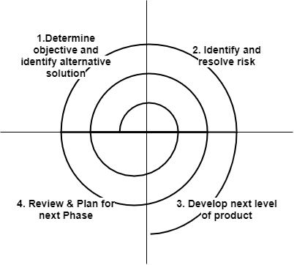
Spiral Methodology
Risk-driven process model.
Used when requirements are unclear and complex
Large and high budget projects

Slide 8
Spiral Methodology
Advantage
High amount of risk analysis
Useful for large and mission-critical projects.
Disadvantage
Can be a costly model to use.
Risk analysis needed highly particular expertise
Doesn't work well for smaller projects.

Slide 9
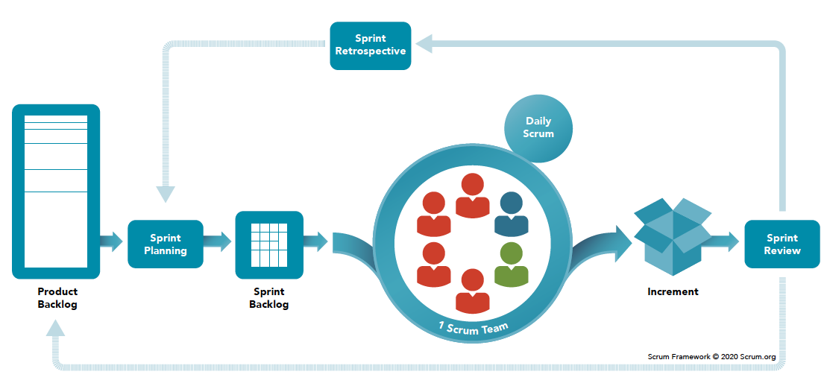
Scrum Methodology
It employs an iterative and incremental approach, organizing work into short, time-boxed iterations called sprints.
Scrum emphasizes collaboration, self-organization, and continuous improvement within cross-functional teams.

Slide 10
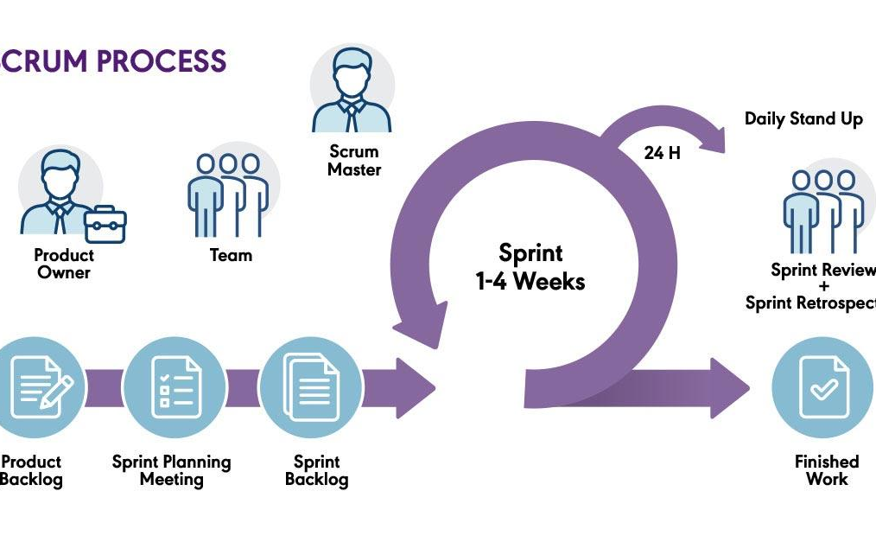

Slide 11
Scrum Methodology
Advantage
Flexibility and adaptability
Enhanced collaboration and communication
Iterative delivery of value
Empowered and self-organizing teams
Disadvantage
Dependency on team collaboration
Unrealistic expectations
Lack of predictability for long-term planning
Limited documentation

Slide 12
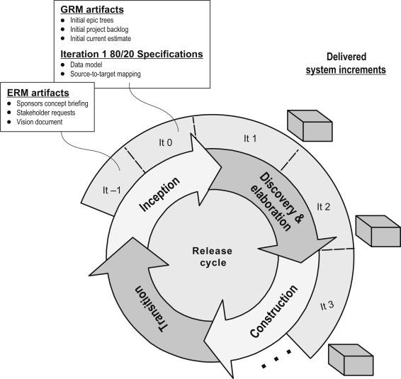
Rational Unified Process(RUP) Methodology
It focuses on four phases: inception, elaboration, construction, and transition, each with specific goals and deliverables.
RUP emphasizes iterative development, risk management, and collaboration among stakeholders.

Slide 13
Rational Unified Process(RUP) Mythology
Advantage
Iterative and incremental approach
Strong focus on quality
Well-defined roles and responsibilities
Tailorability
Disadvantage
Complexity
Potentially lengthy development cycles
Overemphasis on documentation
Steep learning curve

Slide 14
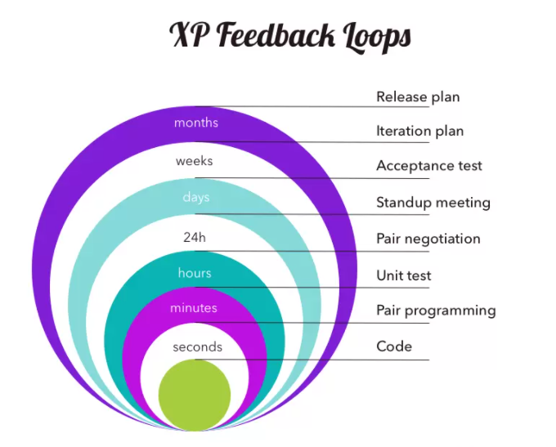
Extreme Programming Mythology
Emphasizes collaboration, simplicity, and iterative development.
It focuses on delivering high-quality software through continuous feedback, frequent releases, and customer involvement. XP employs practices such as pair programming, test-driven development, and continuous integration.

Slide 15
Extreme Programming Mythology
Advantage
Enhanced collaboration and communication
Quick and frequent delivery of working software
Emphasis on quality through testing
Adaptability to changing requirements
Disadvantage
Dependency on team dynamics
Learning curve and skill requirements
Potential for scope creep
Documentation challenges

Slide 16
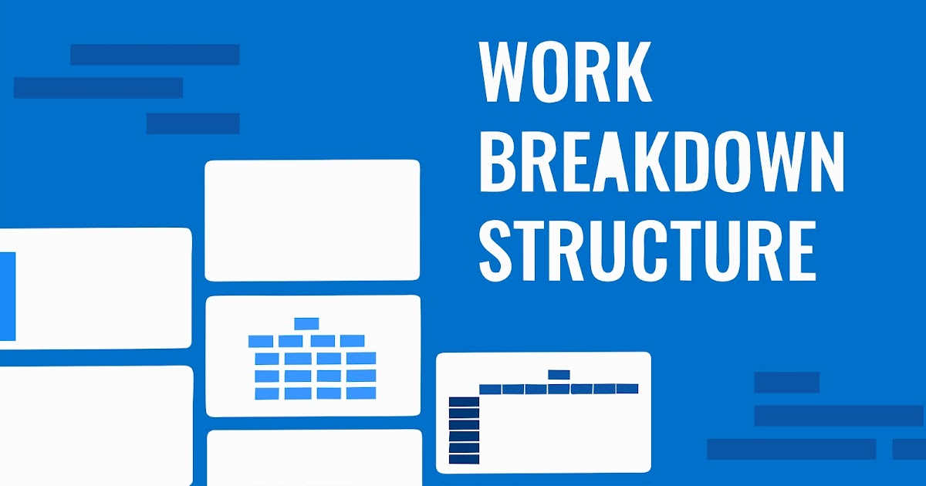

Slide 17
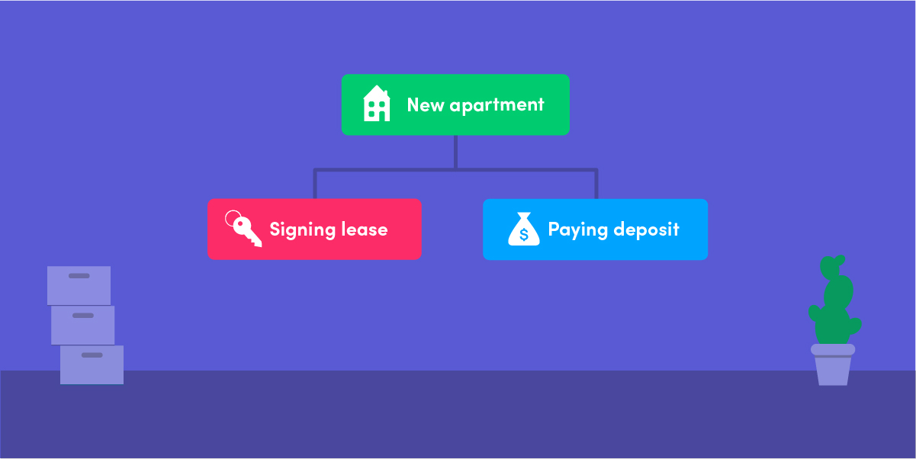
What is Work Breakdown Structures?
Work Breakdown Structures (WBS) is a term used in project management.
PMBOK defines WBS as-“A deliverable-oriented hierarchical decomposition of the work to be executed by the project team to accomplish the project objectives and create the required deliverables”.
It is a visual representation of what has already been done and what should still be done to complete the project.

Slide 18
Work Breakdown Structure (WBS)
The WBS represents a logical decomposition of the work to be performed and focuses on how the product, service, or result is naturally subdivided. It is an outline of what work is to be performed.
LEVEL | ELEMENT DESCRIPTION
1 | Project
2 | Category
3 | Subcategory
4 | Sub-Subcategory
5 | Work Package

Slide 19
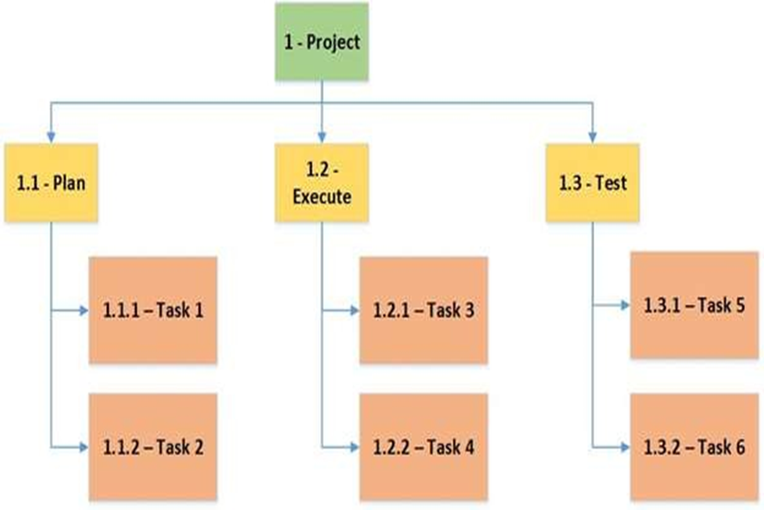

Slide 20
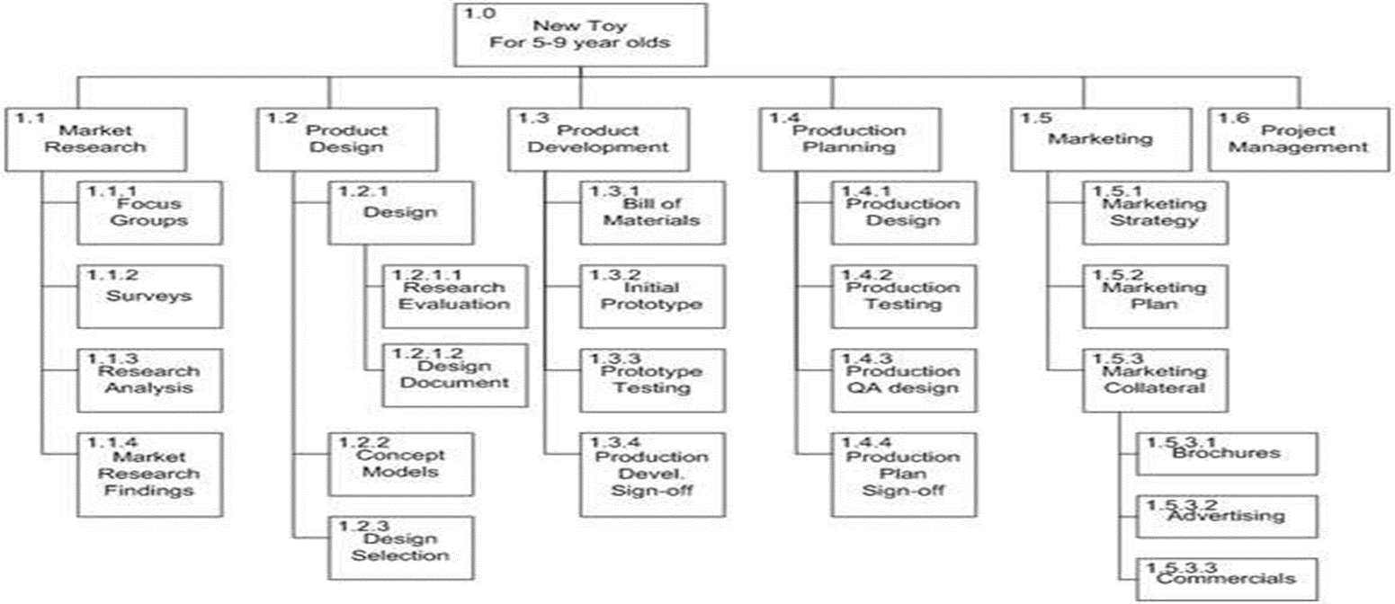
Another example of WBS breakdown

Slide 21
Types of Work Breakdown Structures
There are two types of work breakdown structures commonly employed in project management:
The process-oriented WBS
Deliverable-oriented WBS.

Slide 22
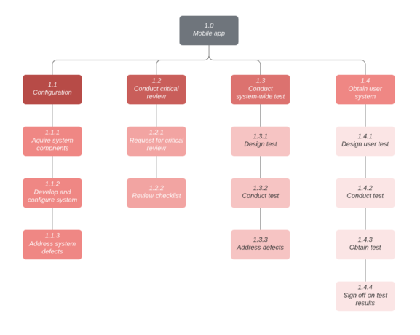
Process-oriented work breakdown structure
A process-oriented WBS defines a project in terms of steps, work phases, or functions. This type of WBS is focused on the steps that need to be taken within individual disciplines to complete a project and typically phrases individual elements in verb form

Slide 23
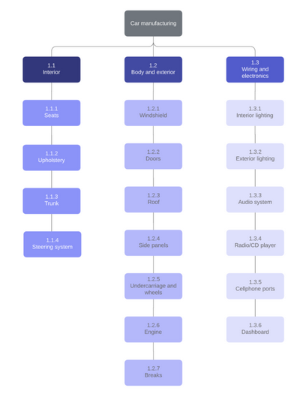
Deliverables-oriented work breakdown structure
A deliverables-oriented WBS defines a project in terms of tangible deliverable components. Deliverables are typically a physical component or item needed to complete the overall project.

Slide 24
WBS Design Principles:
Focus on deliverables, not methods:
The key purpose of a work breakdown structure is to define the main deliverable in terms of the small components that form it. If the deliverable is not a product, then it must provide a specific and measurable outcome.
Mutual Exclusivity:
This could have two possible results:
1. It would duplicate your team’s efforts and create confusion around responsibility, effort, and accounting.
2. A WBS dictionary that describes each component in detail can help void mutual exclusivity.

Slide 25
Follow the 100 percent rule:
To eliminate work that doesn’t contribute to the deliverable, ensure that the sum of all resources in WBS, whether time, money, or another element, adds up to 100 percent. In other words, the elements in level two total 100 percent, and the level three and lower elements roll up into the level two percentage. Your finished project should never total more or less than 100 percent.
Look 2 most Important :
Of all the levels on a WBS, Level-2 is often the most important because it determines how actual costs and schedule data are grouped for future project cost and schedule estimating.

Slide 26
Four Elements in each wbs element:
1. The scope of work, including any deliverables.
2. Timeline for the scope of work.
3. The budget for the work.
4. The name of the person responsible .
40 hour Rule of Decomposition
when a project has been decomposed down to an element that has about 40 hours of allocated direct labor, there is no need to decompose further
4% rules of Decomposition
With this rule a WBS is adequately decomposed when the lowest element is about 4% of the total project.

Slide 27
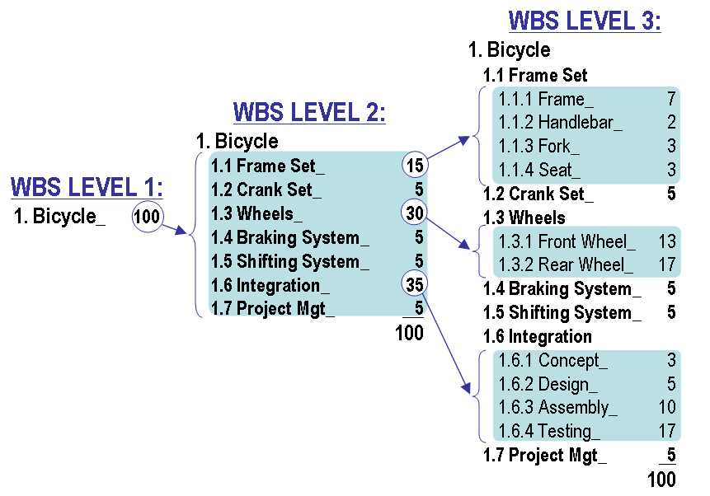
WBS Identification Numbering
This is the outline or index number assigned to each component or step in the process

Slide 28

Project Estimation
Project estimation is a method of analyzing data to develop a forecast of the resources, time or budget a team might need to complete a project.

Slide 29
Estimation Techniques
- The Project Management Approach
•Guesstimating
•Delphi Technique
•Time Boxing
•Top-Down
•Bottom Up
•Analogous Estimates (Past experiences)
•Parametric Modeling (Statistical)

Slide 30
Bottom-Up Estimating
-Estimate how long each sub-task will take into an overall time to project completion.
–Most common form of project estimation.
–Schedules & budgets are constructed from the WBS.
–Starts with people who will be doing the work.
–Schedules & budgets are the aggregate of detailed activities & costs.
Top-Down Estimating
-Estimate of how long the whole project will take, than breaking into various task.
-Top and middle managers determine overall project schedule and/or cost.
–Lower level managers are expected to breakdown schedule/budget estimates into specific activities (WBS).
–What a project should cost and how long it should take as decreed by a member of top management who thinks those parameters are appropriate.
–May be a response to the business environment.

Slide 31
Top-Down Estimating Advantages:
Top-down estimating helps teams make quick and informed decisions. It estimates provide context. Then they can work with other teams to develop more comprehensive plans.
Top-down estimates are created with the understanding that the estimates are adjustable. This approach allows for more flexibility with smaller-scale decisions.
Top-down estimating requires less time and effort than other estimating techniques. It’s a valuable approach when one doesn’t have access to all the project specifications or pricing data.
Top-Down Estimating Disadvantages:
Top-down estimates can vary wildly compared to the actual project costs. This happens because of a lack of detailed analysis.
Most top-down estimates rely on historical data and the project manager’s experience. As a result, the final assessment will include assumptions that may be inaccurate.

Slide 32
Bottom-Up Estimating Advantages:
Bottom-up estimates can be very accurate. This is because team members are estimating the piece of work they are responsible for. As they typically have the most knowledge of their work, their estimates tend to be much more accurate.
The time of one work has been underestimated this could be offset by an overestimation of another work. Such errors might therefore not necessarily impact the budget at the project level.
Bottom-up estimating can be used in conjunction with other estimation techniques.
Bottom-Up Estimating Disadvantages:
The underlying assumption is that the project estimate consists of the sum of its pieces. This holds for large and complex projects, in particular.
Bottom up estimation method requires a significant investment of time. This is particularly not feasible for projects with shorter deadlines.
The cost estimation is based on the duration estimate. Both rely on the estimated resource requirements. An estimation error there would lead to inaccurate time and cost estimates as well.

Slide 33
WBS Checklist
Checklist:
If it does define 100% of the work that will be produced by the project
If it does each element represent a deliverable
If there are a hierarchical structure used
If it does have a least two levels with at least one level of decomposition.
Is there a hierarchical structure used
If it does allow to estimate costs accurately
The checklist can be used to assure that the project has completed the activities related to an effective Work Breakdown Structure and what if the WBS define 100% of the scope of the project or not.

Slide 34
Methodology Infographics
Step 01
Step 02
Step 03
Mercury is the smallest planet of them all
Jupiter is the biggest planet of them all
Venus has a very poisonous atmosphere

Slide 35
Methodology Infographics
Mercury is the closest planet to the Sun and the smallest one in the Solar System—it’s only a bit larger than the Moon
1
Venus has a beautiful name and is the second planet from the Sun. It’s terribly hot—even hotter than Mercury—and its atmosphere is extremely poisonous
2
Despite being red, Mars is actually a cold place. It’s full of iron oxide dust, which gives the planet its reddish cast
3
It’s a gas giant and also the biggest planet in the Solar System. Jupiter is the fourth-brightest object in the sky
4

Slide 36
Methodology Infographics
1
2
3
4
Mars
Mercury
Jupiter
Venus
Mars is actually a cold place. Is a planet full of iron oxide dust
It’s the smallest and closest planet to the Sun in the Solar System
It’s a gas giant and also the biggest planet in the Solar System
It has a beautiful name and is the second planet from the Sun

Slide 37
Methodology Infographics
Step 1
Step 2
Step 3
Mercury is the closest planet to the Sun and smallest one of all
It has a really beautiful name and is the second planet from the Sun
Mars is actually a very cold place. It is full of red iron oxide dust

Slide 38
Methodology Infographics
Jupiter
Jupiter is a gas giant and the biggest planet in the Solar System
Mars
Despite being red, Mars is actually a cold place. It’s full of iron oxide dust
Saturn
Saturn is a gas giant, composed mostly of hydrogen and helium

Slide 39
Methodology Infographics
Mercury is the smallest planet of them all
Venus has a very poisonous atmosphere
Earth is the planet where we live on
Jupiter is the biggest planet of them all
Saturn is the ringed planet from the Sun

Slide 40
Methodology Infographics
Mercury
Mercury is the smallest planet
Neptune
Venus
Jupiter is the biggest planet
Venus has a very poisonous
Mars
Mars is full of iron oxide dust
Saturn
Saturn is the ringed planet

Slide 41
Methodology Infographics
1st
2nd
3rd
4th
5th
Mercury is the smallest planet in the Solar System
Venus it’s the smallest and closest planet to the Sun
Despite being red, Mars is actually a
cold place
Jupiter is a gas giant and the biggest planet of them all
Neptune is the fourth-largest planet in the Solar System

Slide 42
Methodology Infographics
Step 1
Step 2
Step 3
Step 4
Step 5
Mercury is the smallest planet
Venus has a beautiful name
Saturn is the ringed planet
Jupiter is the biggest planet
Mars is actually a cold place

Slide 43
Methodology Infographics
Mercury
Venus
Mercury is the closest planet to the Sun and smallest one in the Solar System
Venus has a beautiful name and is the second planet from the Sun
Saturn
Jupiter
Saturn is a gas giant, composed mostly of hydrogen and helium
Jupiter is a gas giant and actually also the biggest planet in the Solar System

Slide 44
Methodology Infographics
4th
It’s a cold place. It’s full of iron oxide dust
2nd
It’s the biggest planet in the Solar System
3rd
Venus has a very beautiful name
1st
It’s the smallest planet of them all

Slide 45
Methodology Infographics
Saturn
Mars
Saturn is a gas giant, composed mostly of hydrogen and helium
3
4
Mars is actually a cold place. It’s a planet full of iron oxide dust
Venus
Jupiter
2
5
Venus has a beautiful name and is the second planet from the Sun
Jupiter is a gas giant and actually also the biggest planet in the Solar System
Mercury
Mercury is the closest planet to the Sun and smallest one
1

Slide 46
Methodology Infographics
1st
2nd
3rd
4th
It has a beautiful name, but it is incredibly hot
Venus has a beautiful name and is the second planet
Despite being red, Mars is actually a really cold place
Jupiter is the biggest planet in the Solar System

Slide 47
Methodology Infographics
1st
Venus has a very poisonous atmosphere
3rd
Neptune is the farthest planet from the Sun
2nd
Jupiter is the biggest planet in the Solar System
4th
Saturn is a gas giant and has multiple rings
5th
Mercury is the smallest planet in the Solar System

Slide 48
Methodology Infographics
Venus
Venus has a beautiful name
Jupiter is the biggest planet
Neptune
Mars
Mars is actually a cold place
Mercury is the smallest planet
Mercury

Slide 49
Methodology Infographics
Venus
Venus has a beautiful name
Neptune
Neptune is very far away
Mars
Mars is actually a cold place
Earth
Mercury is the smallest planet

Slide 50
Methodology Infographics
Venus
Venus has a beautiful name
Jupiter
Jupiter is the biggest planet
Neptune
Neptune is very far away
Mars
Mars is actually a cold place
Saturn
It has several rings
Earth
Mercury is the smallest planet

Slide 51
Methodology Infographics
Venus
Jupiter
Venus is the second planet from the Sun
Jupiter is the biggest planet of them all
Saturn
2
3
Mercury
Saturn is a gas giant and has several rings
Mercury is the closest planet to the Sun
1
4

Slide 52
Methodology Infographics
Mercury is the closest planet to the Sun and the smallest one in the Solar System—it’s only a bit larger than the Moon
Venus has a beautiful name and is the second planet from the Sun. It’s terribly hot—even hotter than Mercury
Earth is the only planet with life
Despite being red, Mars is a cold place. It’s full of iron oxide dust, which gives the planet its reddish cast
It’s a gas giant and also the biggest planet in our Solar System. Jupiter is the fourth-brightest object in the sky
It’s a gas giant and also the biggest planet in the Solar System. Jupiter is the fourth-brightest object in the sky

Slide 53
Methodology Infographics
Mercury is the closest planet to the Sun and smallest one in the Solar System
Jupiter is a gas giant and actually also the biggest planet in the Solar System
Saturn is a gas giant in the Solar System, composed mostly of hydrogen and helium
Venus has a beautiful name and is the second planet from the Sun in the Solar System

Slide 54
Methodology Infographics
Venus has a beautiful name
Mercury is the smallest planet
Neptune is very far away
Jupiter is the biggest planet
Mars is actually a cold place

Slide 55
Methodology Infographics
1
Saturn
Saturn is a gas giant, composed mostly of hydrogen and helium
2
Venus
1
Mars
4
5
2
Venus has a beautiful name and is the second planet from the Sun
Mars is actually a cold place. It’s a planet full of iron oxide dust
4
3
3
Mercury
Jupiter
5
Mercury is the closest planet to the Sun and smallest one
Jupiter is a gas giant and actually also the biggest planet in the Solar System

Slide 56
Methodology Infographics
Venus
Neptune
Mars
Mercury
Jupiter
Venus has a beautiful name, but also high temperatures
Neptune is the fourth-largest planet in the Solar System
Mars is actually a cold place. It’s full of red iron oxide dust
Mercury is the closest planet to the Sun and the smallest
Jupiter is a gas giant and the biggest planet of them all

Slide 57
Methodology Infographics
Saturn
Saturn is not solid like Earth, but is instead a giant gas planet. It is made up of 94% hydrogen, 6% helium and small amounts of methane and ammonia. Hydrogen and helium are what most stars are made of
Jupiter
It is a gas giant with a mass one-thousandth that of the Sun, but two-and-a-half times that of all the other planets in the Solar System combined. Jupiter is one of the brightest objects visible to the naked eye in the night sky
Venus
Venus has a beautiful name and is the second planet from the Sun. It’s terribly hot—even hotter than Mercury—and its atmosphere is extremely poisonous. It’s the second brightest natural object in the night sky after the Moon

Slide 58
Methodology Infographics
03
Mars is actually a cold place
01
02
Jupiter is the biggest planet
Mercury is the smallest planet
04
05
Venus has a beautiful name
Neptune is very far away

Slide 59
Methodology Infographics
1
2
3
4
5
Mars
Mercury
Jupiter
Venus
Neptune
Mars is a cold place, not hot. Is a planet full of iron oxide dust
It’s the smallest and closest planet to the Sun in the Solar System
It’s a gas giant and also the biggest planet in the Solar System
It has a beautiful name and is the second planet from the Sun
Neptune is the fourth-largest one by diameter in the Solar System

Slide 60
Methodology Infographics
01
03
05
Jupiter is the biggest planet of them all
Venus has a very poisonous atmosphere
Neptune is the farthest planet from the Sun
02
04
Mercury is the smallest planet of them all
Saturn is the ringed planet from the Sun

Slide 61
Instructions for use (free users)
In order to use this template, you must credit Slidesgo by keeping the Thanks slide.
You are allowed to:
Modify this template.
Use it for both personal and commercial purposes.
You are not allowed to:
Sublicense, sell or rent any of Slidesgo Content (or a modified version of Slidesgo Content).
Distribute this Slidesgo Template (or a modified version of this Slidesgo Template) or include it in a database or in any other product or service that offers downloadable images, icons or presentations that may be subject to distribution or resale.
Use any of the elements that are part of this Slidesgo Template in an isolated and separated way from this Template.
Delete the “Thanks” or “Credits” slide.
Register any of the elements that are part of this template as a trademark or logo, or register it as a work in an intellectual property registry or similar.
For more information about editing slides, please read our FAQs or visit Slidesgo School:
https://slidesgo.com/faqs and https://slidesgo.com/slidesgo-school

Slide 62
Instructions for use (premium users)
In order to use this template, you must be a Premium user on Slidesgo.
You are allowed to:
Modify this template.
Use it for both personal and commercial purposes.
Hide or delete the “Thanks” slide and the mention to Slidesgo in the credits.
Share this template in an editable format with people who are not part of your team.
You are not allowed to:
Sublicense, sell or rent this Slidesgo Template (or a modified version of this Slidesgo Template).
Distribute this Slidesgo Template (or a modified version of this Slidesgo Template) or include it in a database or in any other product or service that offers downloadable images, icons or presentations that may be subject to distribution or resale.
Use any of the elements that are part of this Slidesgo Template in an isolated and separated way from this Template.
Register any of the elements that are part of this template as a trademark or logo, or register it as a work in an intellectual property registry or similar.
For more information about editing slides, please read our FAQs or visit Slidesgo School:
https://slidesgo.com/faqs and https://slidesgo.com/slidesgo-school

Slide 63
Infographics
You can add and edit some infographics to your presentation to show your data in a visual way.
Choose your favourite infographic and insert it in your presentation using Ctrl C + Ctrl V or Cmd C + Cmd V in Mac.
Select one of the parts and ungroup it by right-clicking and choosing “Ungroup”.
Change the color by clicking on the paint bucket.
Then resize the element by clicking and dragging one of the square-shaped points of its bounding box (the cursor should look like a double-headed arrow). Remember to hold Shift while dragging to keep the proportions.
Group the elements again by selecting them, right-clicking and choosing “Group”.
Repeat the steps above with the other parts and when you’re done editing, copy the end result and paste it into your presentation.
Remember to choose the “Keep source formatting” option so that it keeps the design. For more info, please visit Slidesgo School.

